Slide 1
Treasury Management
Treasury Systems

Slide 2
Introduction
Treasurer requires information that is not normally available through a company’s standard accounting system or even its Enterprise Resources Planning (ERP) systems
Treasury systems are needed so as to integrate information from a variety of sources, yielding real-time information that the treasury staff can use to efficiently perform their tasks.
A treasury management system (TMS) is a software application which automates the process of managing a company's financial operations

Slide 3
Treasurer’s Technology Needs
Since treasury is relatively a small department, it may not command the resources that larger departments command
Consequently, the treasurer must prioritize information needs.
The following list establishes a set of priorities:

Slide 4
Treasurer’s Technology Needs
Cash position: treasurer overriding obligation is to ensure that the company has adequate cash to fund operations. The following technology needs are critical:
Cashbook balance tracking
Multibank reporting of balance information
Cash pooling management

Slide 5
Treasurer’s Technology Needs
Cash forecasting and reconciliation
Funds transfer capability
Investment management, including money market dealing
Interest income calculation
Debt management
Payment processing

Slide 6
Treasurer’s Technology Needs
Intercompany transactions settlement with notional accounts

Slide 7
Treasurer’s Technology Needs
2. Foreign exchange transactions: some companies have little foreign business that FX transactions are negligible. Larger firms with established treasury operations will likely need ongoing purchase and sale of multiple currencies. The following technology needs arise:
Rate feeds from Bloomberg or Reuters
Intercompany netting capability

Slide 8
Treasurer’s Technology Needs
Foreign exchange forecasting and position analysis
Foreign exchange bid summarization
Foreign exchange deal-making capability
Foreign exchange confirmation processing

Slide 9
Treasurer’s Technology Needs
3. Hedging: for those companies that choose to hedge their interest rates or foreign exchange rate positions, the following technology requirements maybe needed
Rate feeds from Bloomberg or Reuters
Exposure modeling capability
Hedge deal-making capability
Hedge confirmation processing
Hedge documentation capability

Slide 10
Treasurer’s Technology Needs
In addition to these three core areas, the treasurer also needs a reporting system that reveals the global cash position, investment portfolio, debt portfolio, cash forecast, and foreign exchange transactions
The system should also provide mark-to-market valuations, scenario analysis and counter party risk summaries
This information can be presented through a customised dashboard that is updated in real time

Slide 11
Treasurer’s Technology Needs
The treasurer’s technology needs to extend to the efficiency of and control over treasury activities:
Efficiency Issues
Minimise data entry- system should never require manual entry of a transaction into the system more than once and ideally should involve automated data collection and posting

Slide 12
Treasurer’s Technology Needs
Work flow processing- if supervisory approval is required, the system should electronically route transaction to correct supervisor for approval
b) Control Issues
Audit trail- all treasury transactions should result in a clearly defined audit trail that identifies who made a transaction and the date, amount and accounts impacted by the transaction

Slide 13
Treasurer’s Technology Needs
Segregation of duties- the system should limit access to certain modules and require approval of key transactions
Warning indicators- the system should automatically notify users if transaction confirmations have not been received, if hedging policies are being violated, if there are negative cash balances etc

Slide 14
Treasury Management System
Treasury management systems is costly
The expense can be justified by the fact that it automates many rote treasury tasks
The system will be less expensive and easier to install if the treasurer reduces the number of outside banking relations that the company has, so that there are fewer customised interfaces to construct

Slide 15
Treasury Management System
The system can be complex such that there is a risk that it will not be fully utilized as employees will only gain expertise in specific functions that they were performing prior to system installation
The firm can schedule training for all affected personnel in all functions of the system
They can also schedule an audit of system usage months after installation to determine which features are not being used

Slide 16
Treasury Management System
The firm can justify the cost of acquiring the system by looking at the cost of a failed manual system, such as a spread sheet error
Another option is to enlist the internal auditors, who can argue that the risk of a transactional error may result in a Sarbanes-Oxley control breach that would have to be revealed in a company’s filings

Slide 17
Treasury Management System
Third alternative is to explore a third party hosting solution, which substitutes the large up-front capital cost of a treasury management system for an on going monthly fee.
In none of the above work, the treasurer should attempt to at least install those portions of a treasury management system that reduce the amount of data entry and repetitive work by the treasury staff so that they concentrate on value adding tasks
https://treasurysystems.com/

Slide 18


Slide 19
SWIFT Connectivity
The Society for Worldwide Interbank Financial Telecommunications (SWIFT) operates a worldwide network that banks use to exchange standardised electronic messages that are known as SWIFT MT codes.
Most banks around the world are part of the SWIFT system, including Zambian banks.
The SWIFT network is highly secure and is designed strictly to transport messages between participants

Slide 20
SWIFT Connectivity
Companies are now able to access the SWIFT network by an number of methods.
However the company cannot deal directly with another corporation, it can only send messages through the bank intermediaries.
Large companies can link their treasury management systems directly into the SWIFT network.

Slide 21
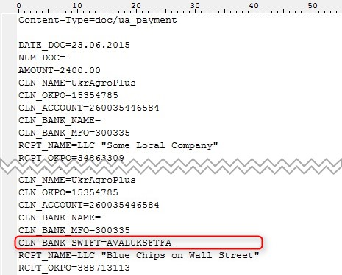
SWIFT Connectivity

